Slide 1
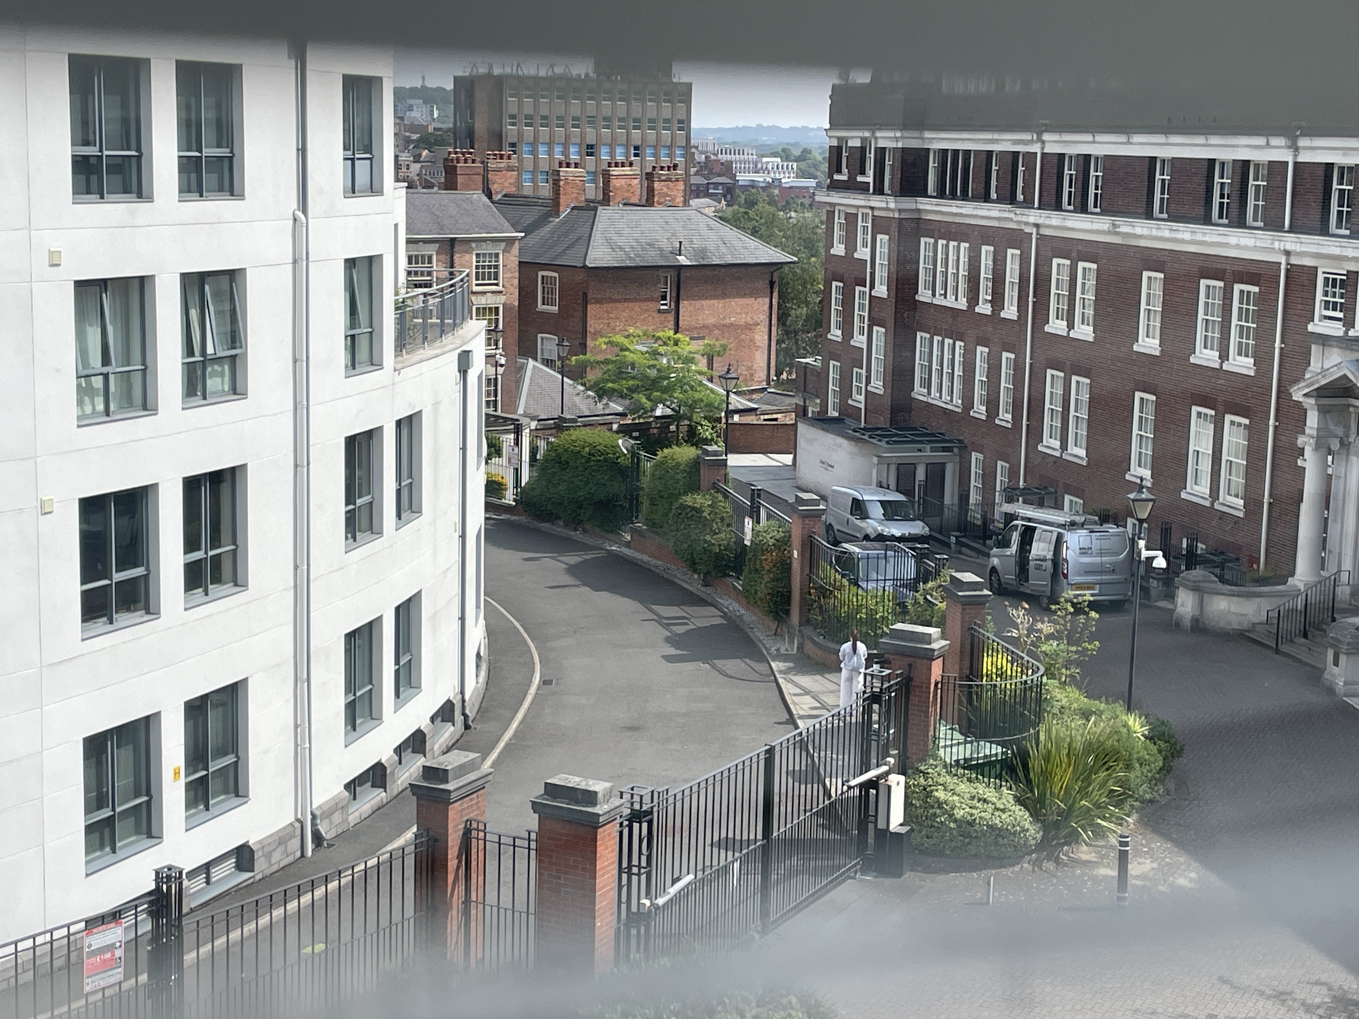
RSH & CP COMPANY LTD
AGM
Royal Standard House & City Point
22 September 2025

Slide 2
Today’s Presentation
Board’s Report
Managing Agent’s Report
Questions are welcome throughout and at the end.
We want to hear your views!

Slide 3
Board’s Report

Slide 4
Summary of the Year
A focus on protecting and maintaining the site:
  RSH roof checked, and leaks repaired
  Work started on CP communal window repairs
  New door entry system installed
  Continued progress on legal issues with 3 &10 RSH
  Fire Door survey completed, and information issued to leaseholders
  New Fire Risk Assessment completed
  Communal areas & CP car park cleared out

Slide 5
Valuation of the Site
Increased insurance reinstatement cost values :
  Royal Standard House = 76% increase
    £18.5m (was £10.5m)
  City Point = 7% increase
    £12.2m (was £11.4m)
  Total; £30.7m
    (was £21.9m, 40% increase)

Slide 6
Service Charge 2024 & 2025
Key budget variances:
Joint - Professional costs reduction - £5k
RSH - Insurance increase - £7.5k; Maintenance saving - £4k;
Electricity saving - £2k; PPM cost - £2k
CP - Insurance increase - £2.7k; Electricity saving - £2k; PPM cost - £2k

Slide 7
Lease Issues and Legal Costs
Two very unusual legal cases
3 RSH – breach of lease with no action to remedy by leaseholders
  Court ordered leaseholders to rectify breaches & pay costs
  Costs paid but no attempt made to agree required work
  Bailiffs attended in August & possession of the apartment taken
  Further claims may be lodged by defendants during a relief period
10 RSH – corporate leaseholder struck off by Companies House
  The apartment reverted to being part of freehold last year
  Notice issued to occupant to leave, which they have challenged
  Procedural hearing scheduled for 17 October
  We continue to seek possession

Slide 8
Lease Extensions – 999 years
A benefit of owning the Freehold
Previously offered 999-year leases but not a high take up
New offer proposed and open to all Company member leaseholders
  Costs…..

Slide 9
Managing Agent’s Report

Slide 10
Water Ingress to Buildings
RSH roof
  Minor leaks fixed and roof integrity checked
  Our contractors believe the roof is in good condition - no substantial spend needed in the next 10 years
CP communal areas
  Long standing leaks - variety of causes and some difficult to pinpoint
  Work has started on repairing seals to windows

Slide 11
Other Items
Door Entry System
  Some teething problems
General site maintenance
  Gardens / Trees
  Jet washing
  Lighting
Fire Door Surveys
  Apartment front doors need your attention
  Communal doors will need significant upgrades
Fire Risk Assessment
  Awaiting report – no serious issues expected
  Evacuation procedures to be clarified
Lease extensions – 999 years

Slide 12
Reminder
Residents and leaseholders are requested to report issues to NG & not just to flag to other residents & leaseholders on WhatsApp

Slide 13
QUESTIONS?

